Slide 1
GOVERNMENT OF ARUNACHAL PRADESH
DEPARTMENT OF COOPERATION
ITANAGAR

Slide 2
STATUS OF COOPERATIVE SOCIETIES OF ARUNACHAL PRADESH
1 | No. of cooperative societies | 1206
2 | No. of Members | 64540
3 | Total Share Capital | 20245.44 (Rs. in lakhs)
4 | No. of Societies under profit | 804
5 | No. of Societies under loss | 124
6 | No. of Societies defunct | 278

Slide 3
CATEGORIES OF COOPERATIVE SOCIETIES
1 | Apex Level Cooperative Societies | 5 nos. |  | 8 | Poultry Cooperative Societies | 2 nos.
2 | LAMPS | 35 nos. |  | 9 | Welfare Cooperative Societies | 3 nos.
3 | Consumer Cooperative Societies | 74 nos. |  | 10 | Housing Cooperative Societies | 1 no.
4 | Multipurpose Cooperative Societies | 899 nos. |  | 11 | Floriculture Cooperative Societies | 1 no.
5 | Marketing & Processing | 7 nos. |  | 12 | Cinema Cooperative Societies | 1 no.
6 | Handloom Cooperative Societies | 38 nos. |  | 13 | Hydropower Cooperative Societies | 1 no.
7 | Farming Cooperative Societies | 24 nos. |  | 14 | Cultural Cooperative Societies | 1 no.

Slide 4
15 | Dairy Cooperative Societies | 18 nos. |  | 21 | Construction Cooperative Societies | 4 nos.
16 | Transport Cooperative Societies | 12 nos. |  | 22 | Cooperative Union | 13 nos.
17 | Industrial Cooperative Societies | 13 nos. |  | 23 | Labour Cooperative Societies | 7 nos.
18 | Thrift & Credit Cooperative Societies | 17 nos. |  | 24 | Fishery Cooperative Societies | 7 nos.
19 | School Cooperative Societies | 10 nos. |  | 25 | Other Cooperative Societies | 10 nos.
20 | Piggery Cooperative Societies | 3 nos.

Slide 5
Cooperative credit structure in arunachal pradesh
Arunachal Pradesh has two tier Cooperative Credit Structure, viz-
1. Large Size Multipurpose Cooperative Society (LAMPS) at Primary level; and
2. Arunachal Pradesh State Cooperative Apex Bank (SCAB) at state level with 37 Branches.

Slide 6
1. ARUNACHAL PRADESH STATE COOPERATIVE APEX BANK LTD.
The LAMPS and Arunachal Pradesh State Cooperative Apex Bank have been mandated with business agenda to provide both short term and long term credit support to the farmers.
In order to provide credit facility to the needy farmers in inaccessible remote areas of the state for their primary based economic activities the State Coop. Apex Bank has taken the following initiatives:-

Slide 7
Customer Service Points:
20 CSPs have been set up through V-Set connectivity and solar power back up to provide Banking Services to the farmers in the un-banked areas.
Three (3) Nos. of Mobile ATM Vans have also been launched for providing services to the customers at their door-steps. This arrangement played a very vital role during the Lockdown period.
Rupay Kissan Credit Card:
The Bank has installed 30 Nos. of ATM, 37 Nos. of Micro ATM in its Branches and provided 20,000 units of RKCCs to the farmers to meet up their immediate credit needs.

Slide 8
2. Large Size Multipurpose Cooperative Societies (LAMPS)
LAMPS are involved in marketing of Agri-Horti and allied Products of farmer members, besides consumer activities for general customers.
Tawang LAMPS and Jang LAMPS in Tawang District play important roles in uplifting the socio-economic condition of their farmer members of Tawang, West Kameng & East Kameng Districts by procuring their surplus Agri-Horti produces and supply them to the Indian Army located in different parts of Arunachal Pradesh.
Both the LAMPS have been awarded NCDC Cooperative excellence awards for their outstanding contribution in primary level cooperative societies.

Slide 9
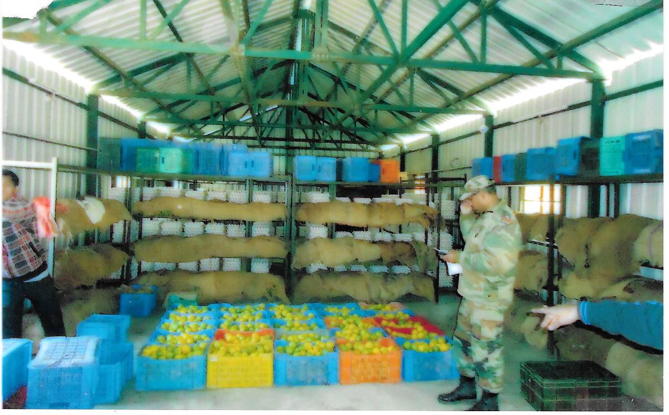
Agriculture produce ready for supply to the Army Units located in different parts of Arunachal Pradesh by Tawang LAMPS Ltd

Slide 10
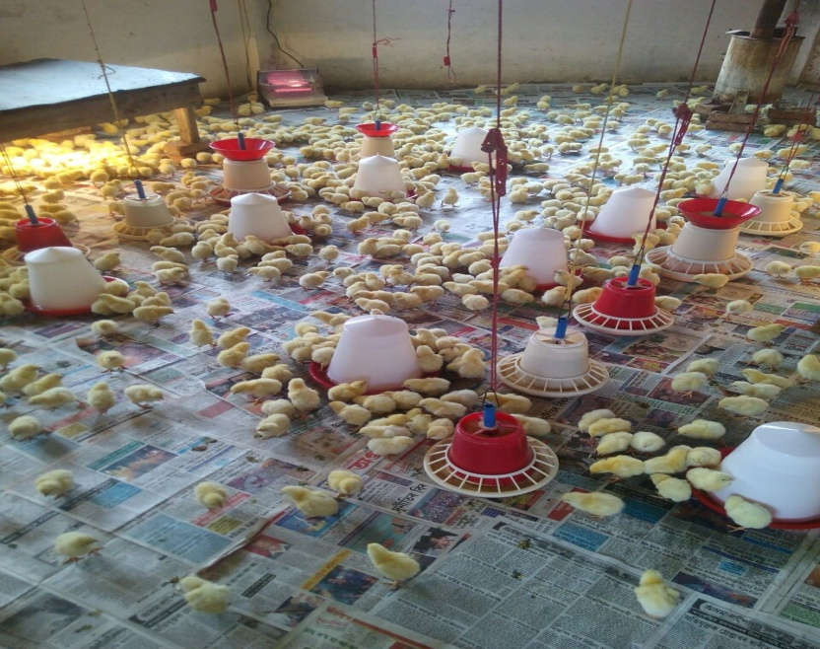
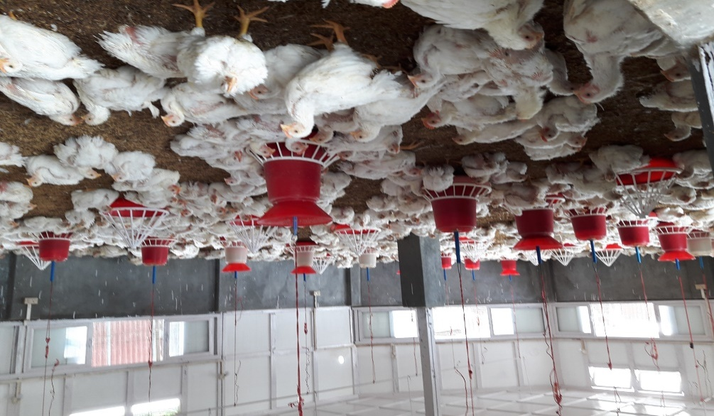
Ziro Poultry Cooperative Farmers Society Ltd, Ziro Lower Subansiri District, Arunachal Pradesh.
Ziro Poultry Cooperative Farmers Society is a role model for poultry farming both in private and public sectors in Arunachal Pradesh.
The Ziro Poultry Cooperative Farmers Society, is also the awardee of NCDC Cooperative Excellence Award, during the Year, 2012 by the then Hon’ble President of India.

Slide 11
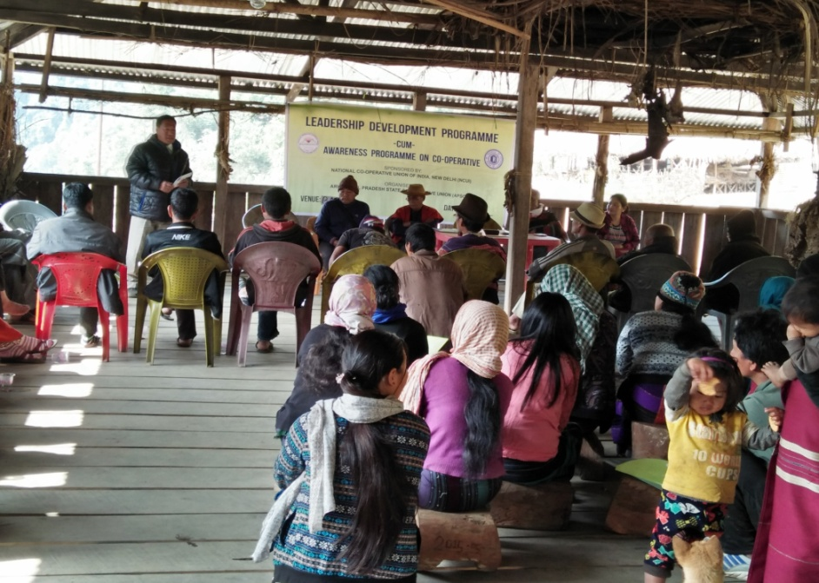
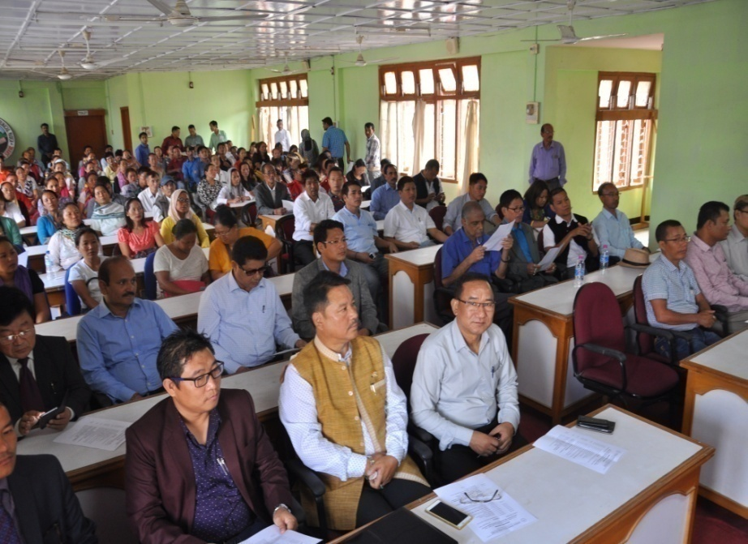
ARUNACHAL PRADESH STATE COOPERATIVE UNION & COOPERATIVE Training Centre
ARUNACHAL PRADESH STATE COOPERATIVE UNION (APSCU) is carrying out different kinds of activities which include Cooperative Education, Training, Publicity, Organising of Conferences, Seminars, Study Tours, Women Cooperative Education Programmes, guiding and encouraging in registration of new cooperative societies, etc.

Slide 12
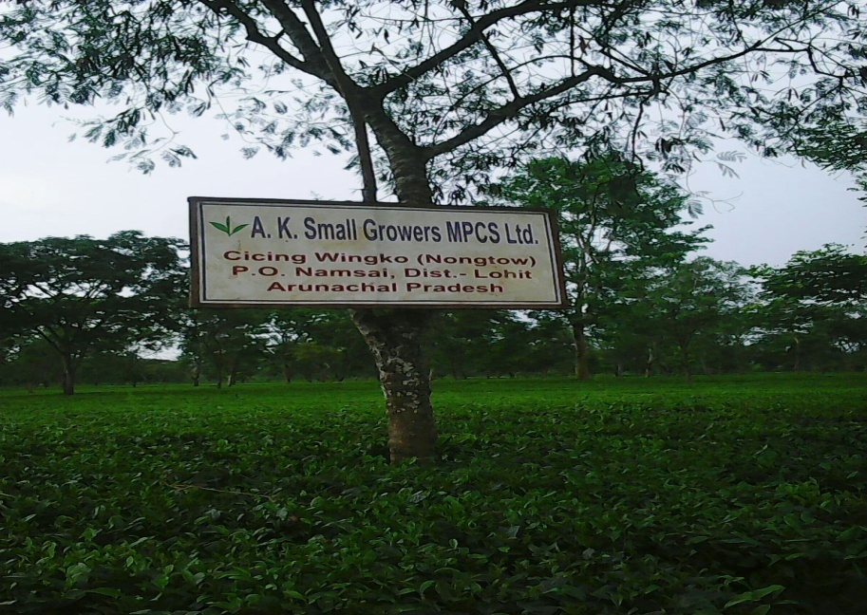
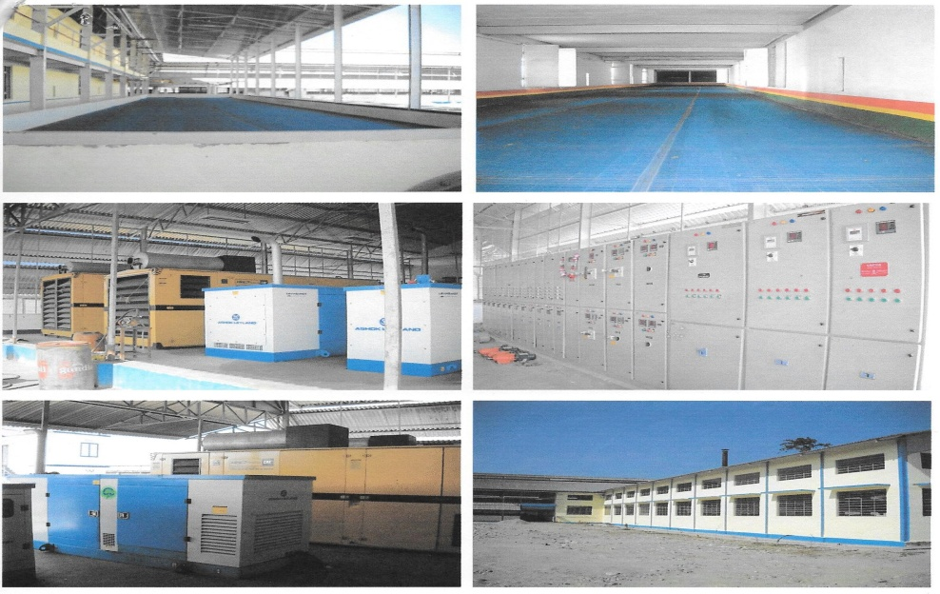
TEA COOPERATIVE SOCIETIES IN ARUNACHAL PRADESH
The land and climatic condition of Arunachal Pradesh, excepting the alpine region is suitable and conducive for Plantation of Tea. For the benefits of Tea Growers in the Eastern parts of Arunachal Pradesh 3 Tea Factories have been established in the Cooperative Sectors with financial assistance from NCDC.
Tea Factory of A.K. Small Growers MPCS Ltd. Namsai

Slide 13
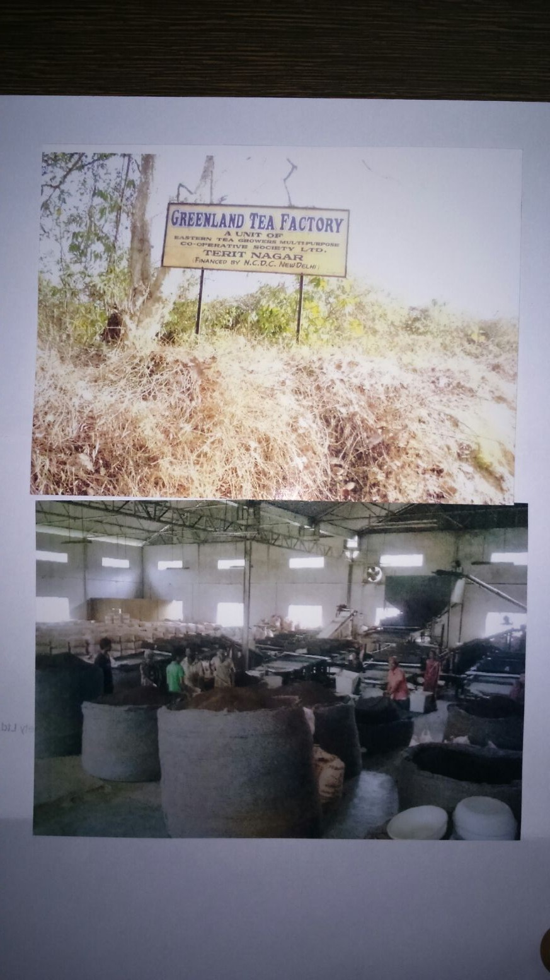
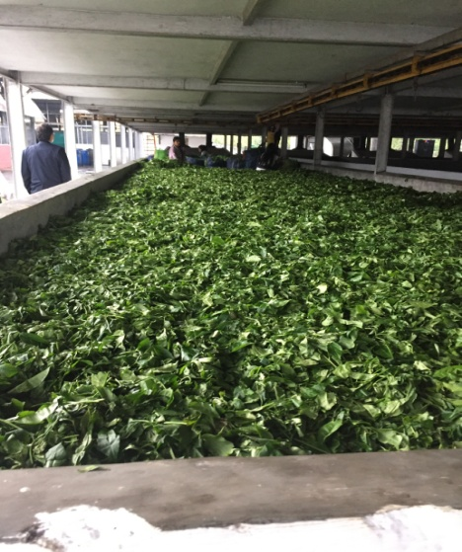
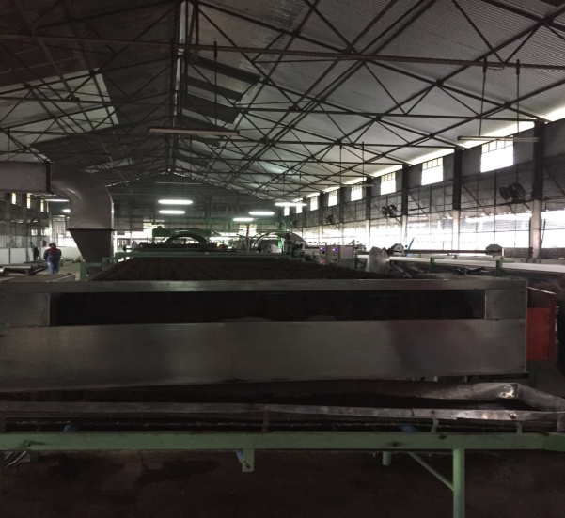
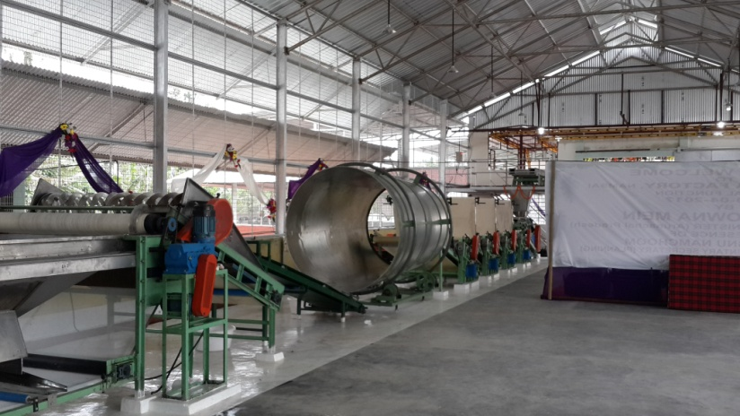
PROCESSED tea of Eastern Tea growers Coop. Society, Jairampur, Changlang
TEA FACTORY OF MARKFED, NAMSAI

Slide 14
In addition to these, as per requirement of time and situation the Cooperative Societies have started diversifying their economic activities ranging from agriculture and allied activities to service sector.
Considering the huge tourism potential in Arunachal Pradesh, some Tourism Cooperative Societies have started organising home-stay facilities showcasing indigenous traditional way of life where local cuisines are provided. This Sector is gaining popularity in the Apatani plateau of Ziro, Lower Subansiri district, Tawang in Tawang District and Mechukha in Shi-Yomi District for which necessary fund has been provided by NCDC for creating necessary tourism infrastructures like, Hotels and Home-Stays.

Slide 15
THANK YOU

